Slide 1
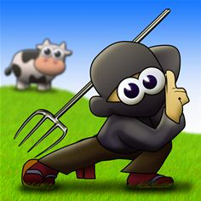
FARM NINJA
1
Haixiao Dai, Yifan Wang and Mads Bjørn
Group 5

Slide 2
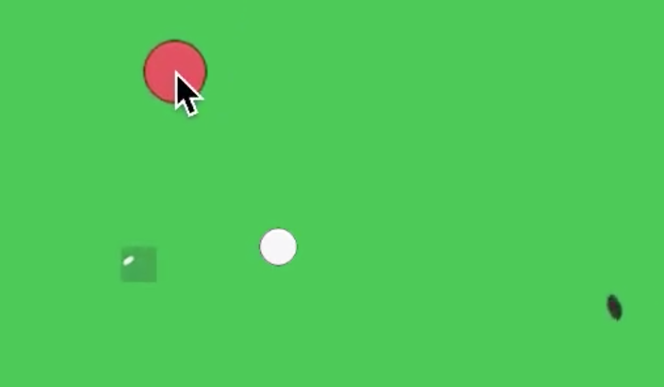
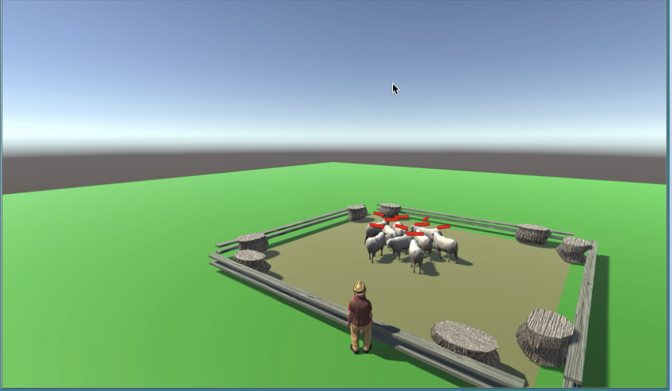
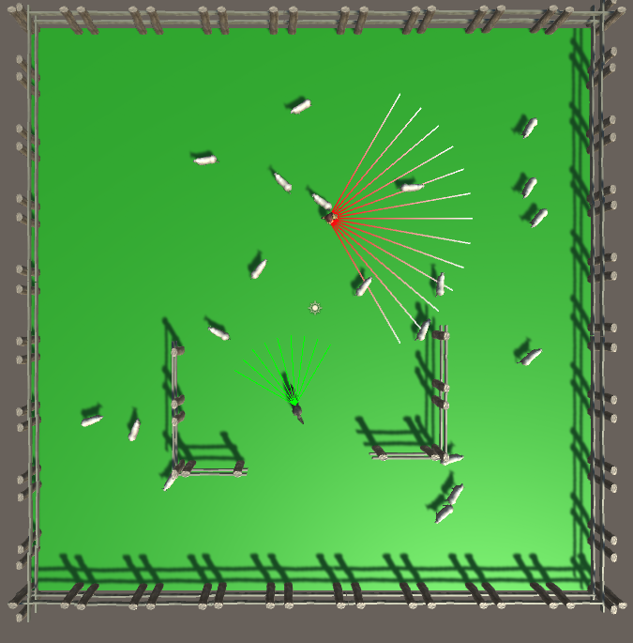
3 people, 3 success stories!
Q-learning on a new 2D version of our game
Decision trees to control fences
Deep Reinforcement Learning for wolf
Haixiao (Hax)
Mads
Yifan

Slide 3
2D version
Goal:
- Qlearning to train "helpers"
- Train on server, without Unity
Rebuild, with no reuse from old 3D game
Without Unity Vector libaries Full steering, flocking and A* pathfinding
Simulate Full game at 60 FPS, at 2800 times real time

Slide 4
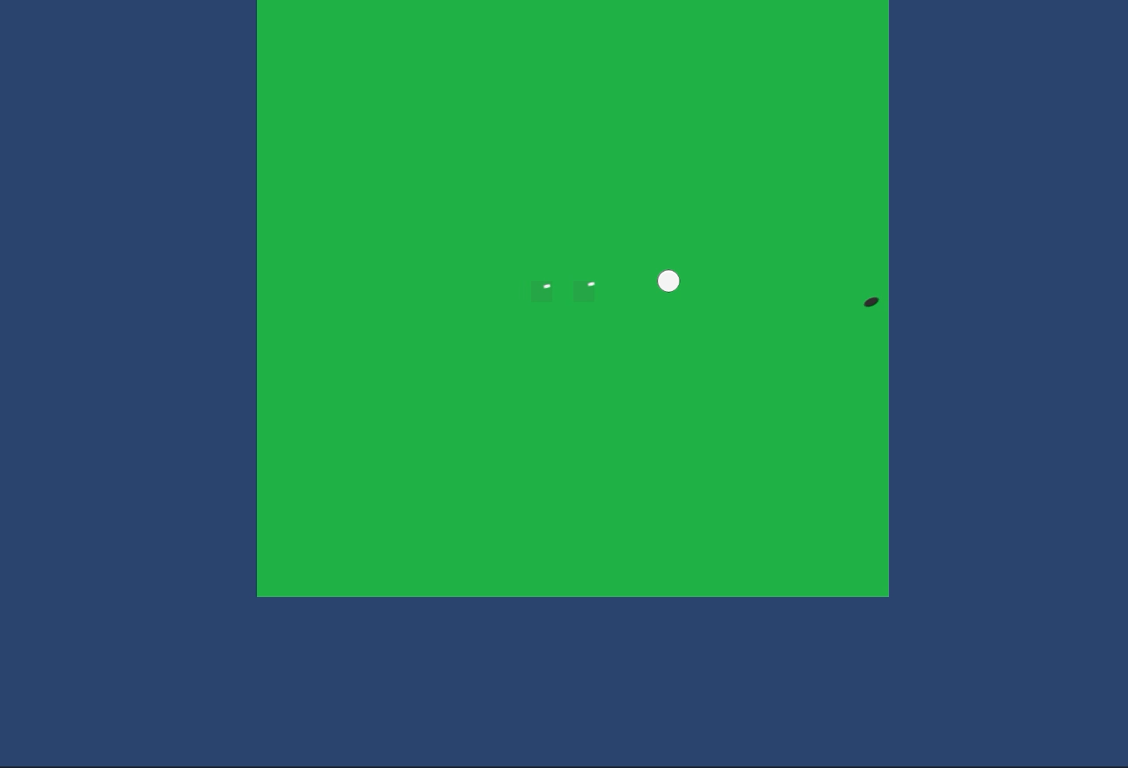
2D version
1 Action:
- Left
- Right
- Up
- Down
- Stay
For 1 second
2Sheep.mov

Slide 5
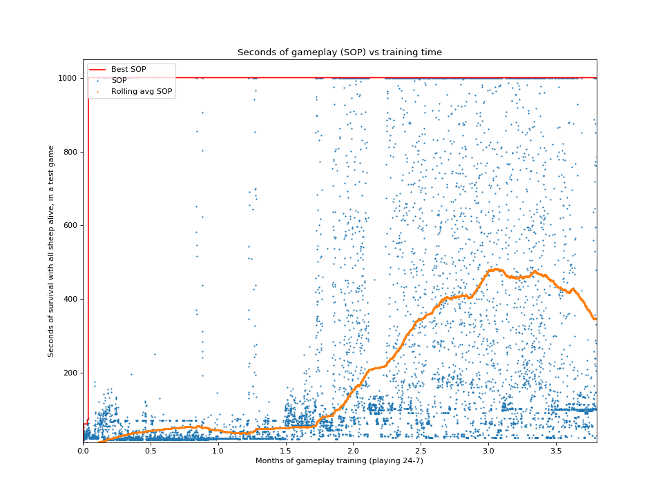
2D version
1 Action:
- Left
- Right
- Up
- Down
- Stay
For 1 second
Tried with different discount factors and rewards

Slide 6
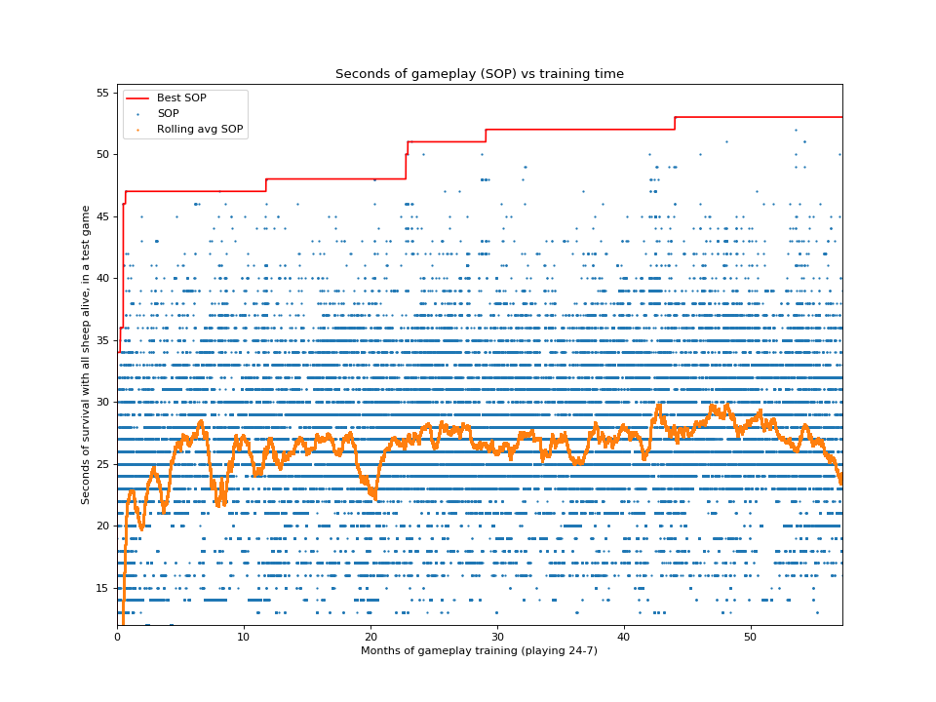
2D version
1 Action:
- Left
- Right
- Up
- Down
- Stay
For 1 second
Tried with different discount factors and rewards

Slide 7
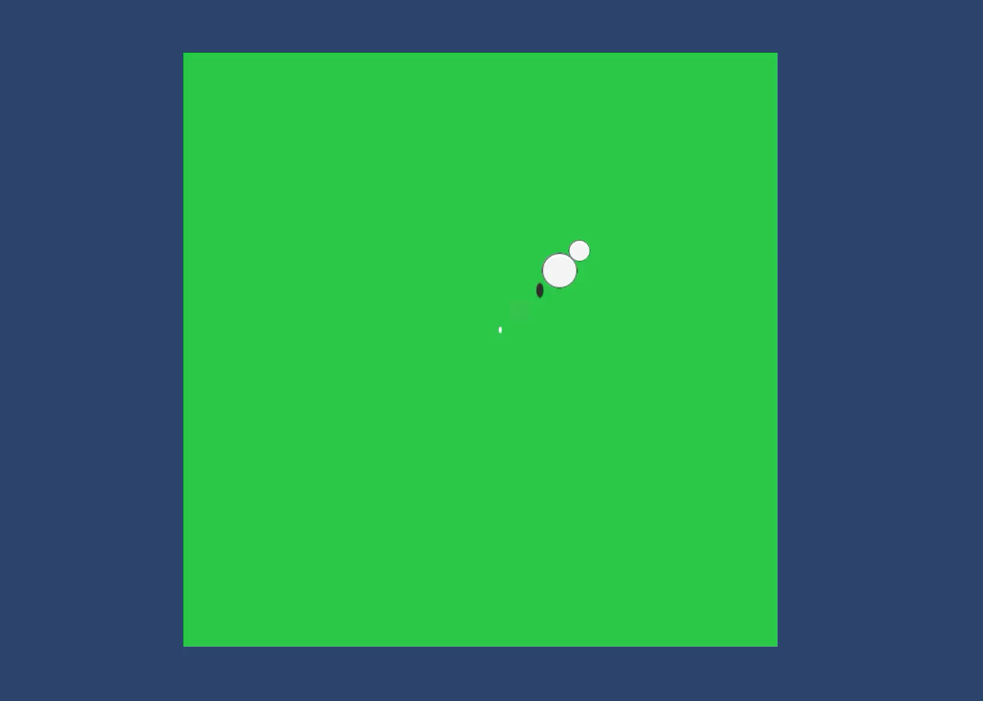
2D version
# of sheep | Time without loosing any sheep | # of iterations | Gametime used
1 | ≈ 3 hours | 10 000 000 | ≈ 0.3 years
2 | ≈ 4 minutes | 150 000 000 | ≈ 4.7 years
3 | ≈ 2 minutes | 200 000 000 | ≈ 6.2 years
4 | ≈ 1 minute | 400 000 000 | ≈ 12 years
1Sheep.mp4

Slide 8
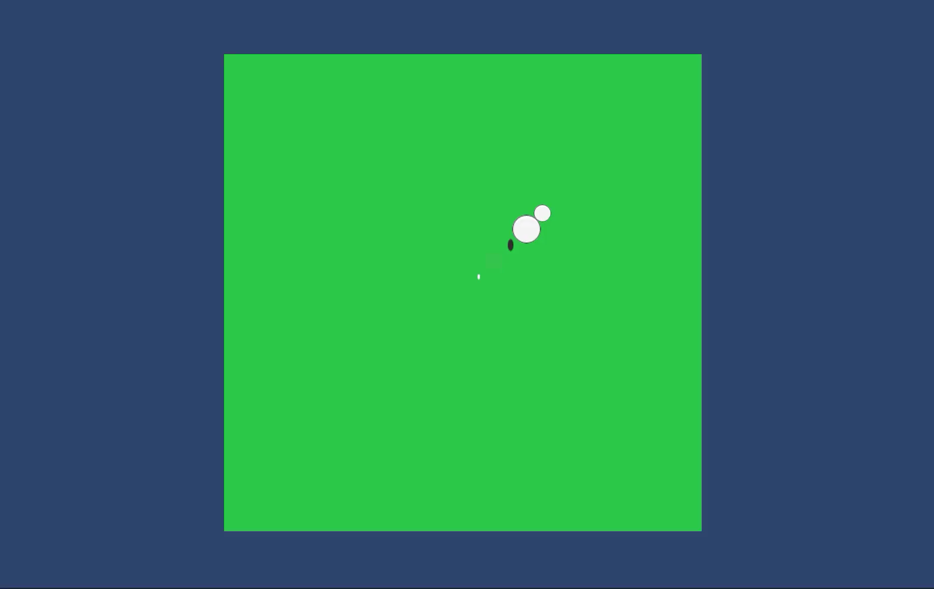
2D version
# of sheep | Time without loosing any sheep | # of iterations | Gametime used
1 | ≈ 3 hours | 10 000 000 | ≈ 0.3 years
2 | ≈ 4 minutes | 150 000 000 | ≈ 4.7 years
3 | ≈ 2 minutes | 200 000 000 | ≈ 6.2 years
4 | ≈ 1 minute | 400 000 000 | ≈ 12 years
3Sheep.mp4

Slide 9
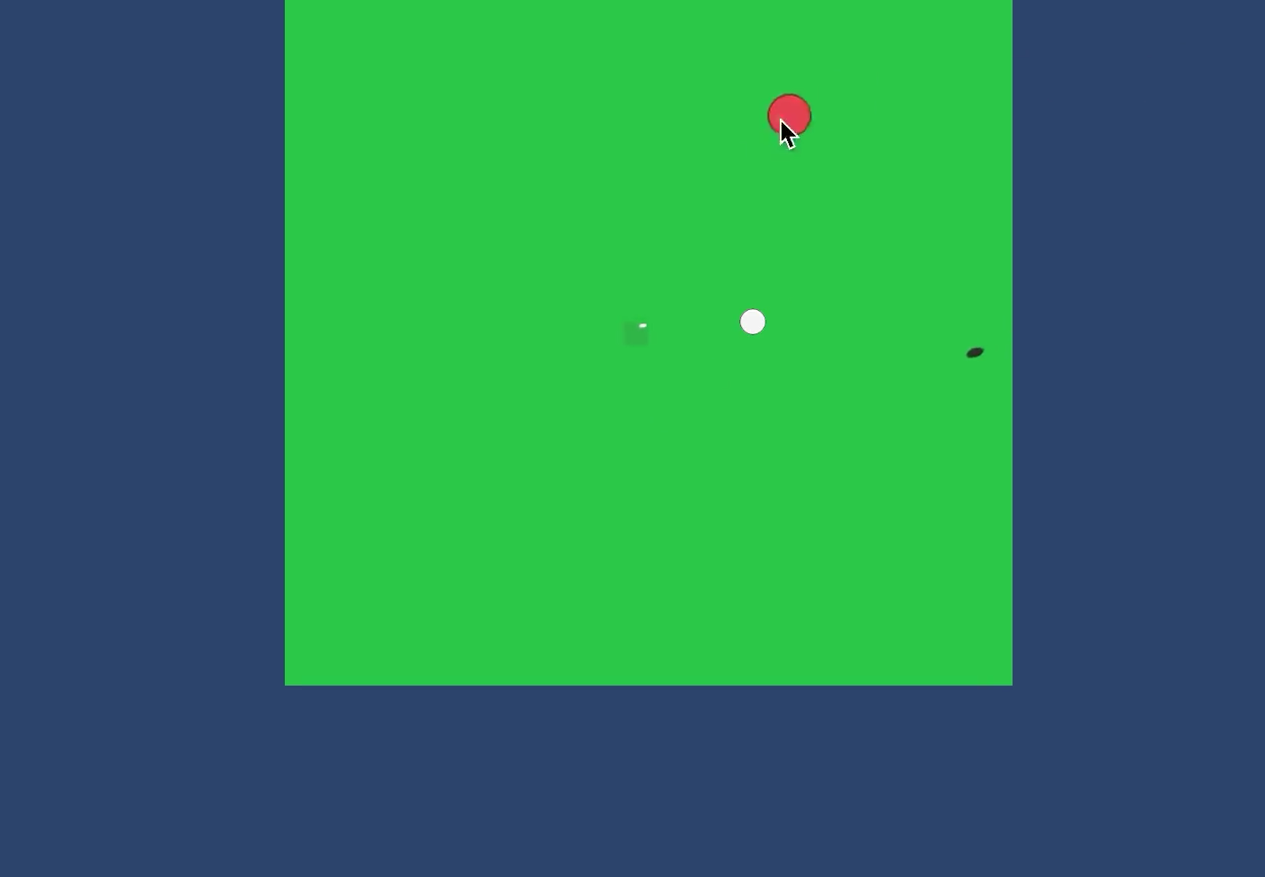
2D version
# of sheep | Time without loosing any sheep | # of iterations | Gametime used
1 | ≈ 3 hours | 10 000 000 | ≈ 0.3 years
2 | ≈ 4 minutes | 150 000 000 | ≈ 4.7 years
3 | ≈ 2 minutes | 200 000 000 | ≈ 6.2 years
4 | ≈ 1 minute | 400 000 000 | ≈ 12 years
1SheepInterference.mp4

Slide 10
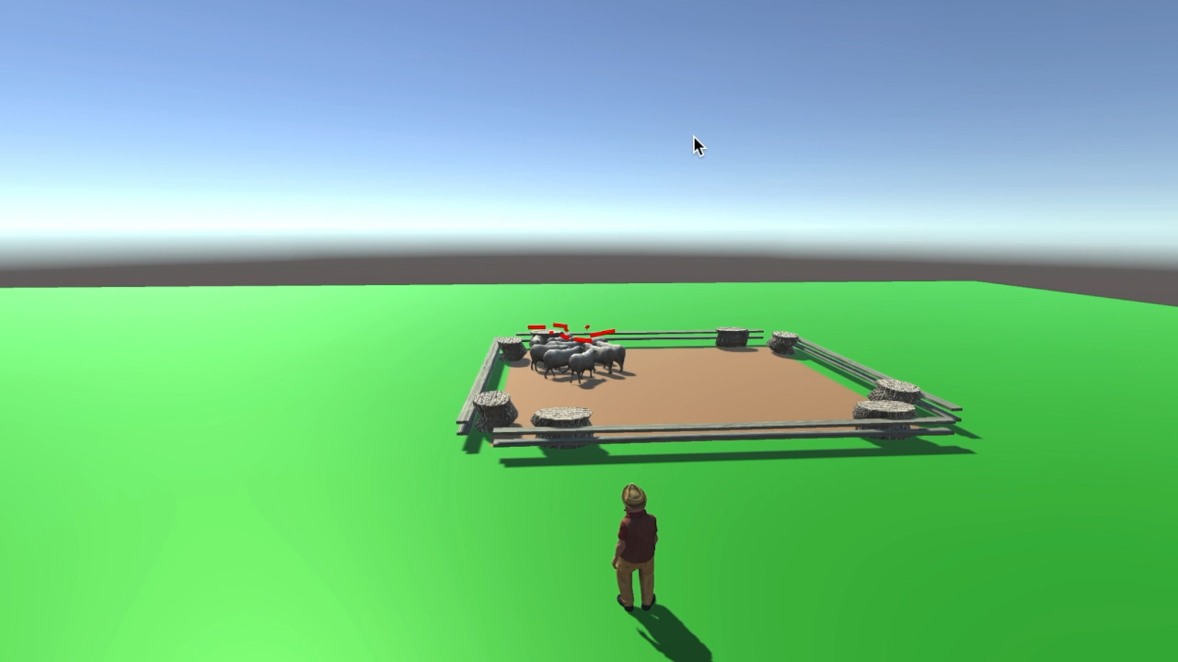

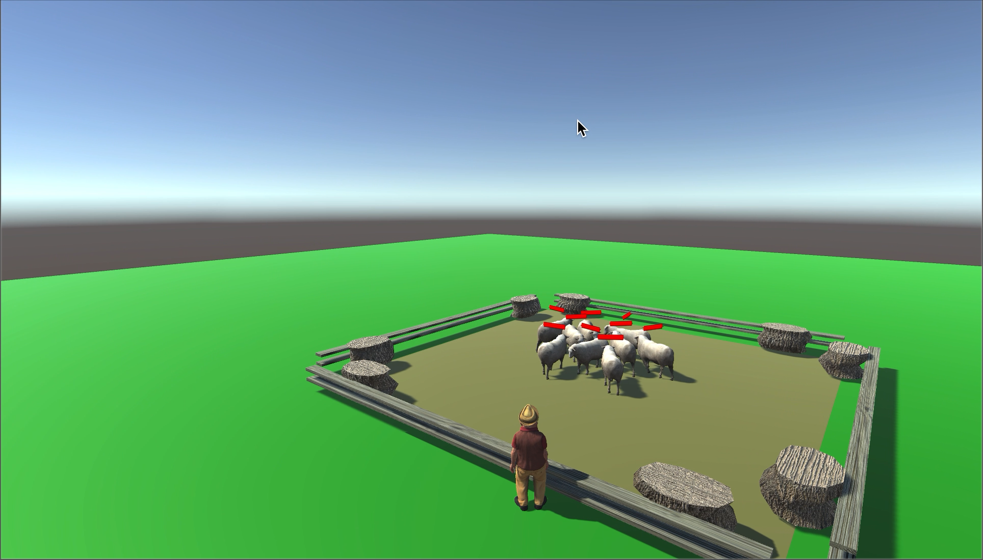
Workflow: observe (collect data) → pre-clean data → generate tree → prune the tree → implement to the game
WEKA: Machine Learning Software in Java
Algorithm: J48, a subset of C4.5
Data collected:
Grass health
Wolf distance
Nearest sheep distance
Sheep position (inside, outside, middle)
Boss position (inside, outside)
Fence status (up, down)

Slide 11
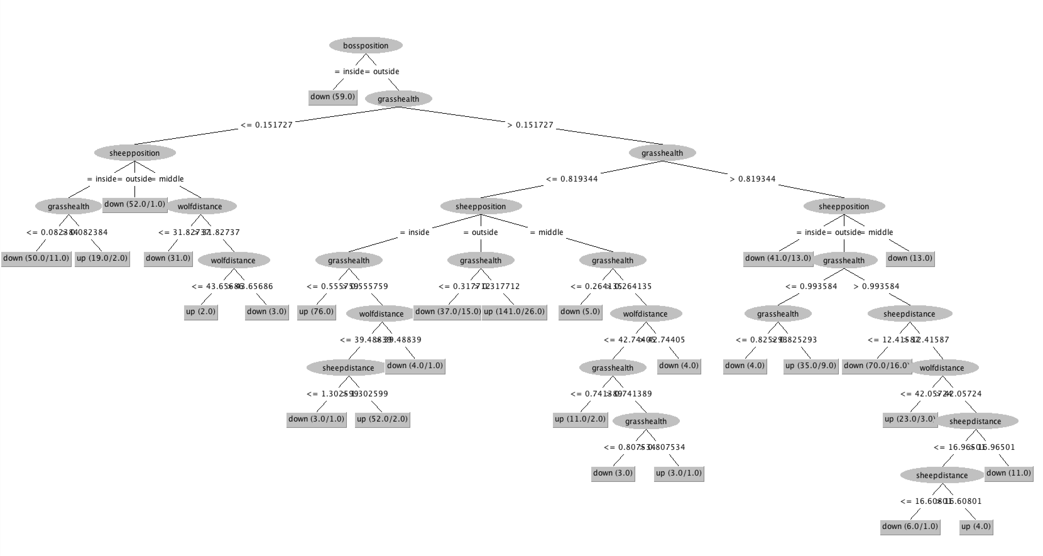
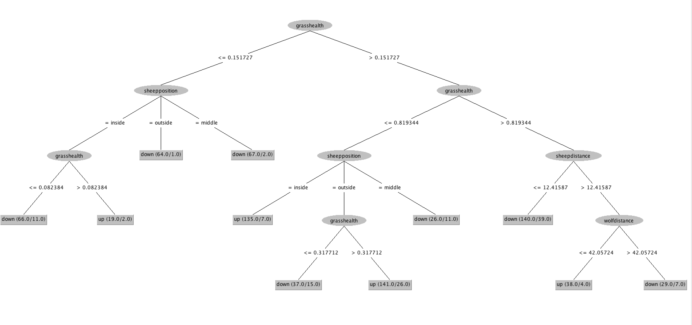
Challenges and problem solving
1. Tree was too big. Solution: Increase “minNumObj” to prune the tree
2. “bossposition” is missing after pruning the tree. Solution: combine two trees in one tree

Slide 12
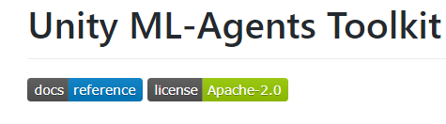
Deep Reinforcement Learning for wolf
Aim
To eat as many sheep as possible
Environment
20 Random Walking Sheep
1 Patrol Farmer
2 Fences as obstacles
4 Fences Wall around

Slide 13
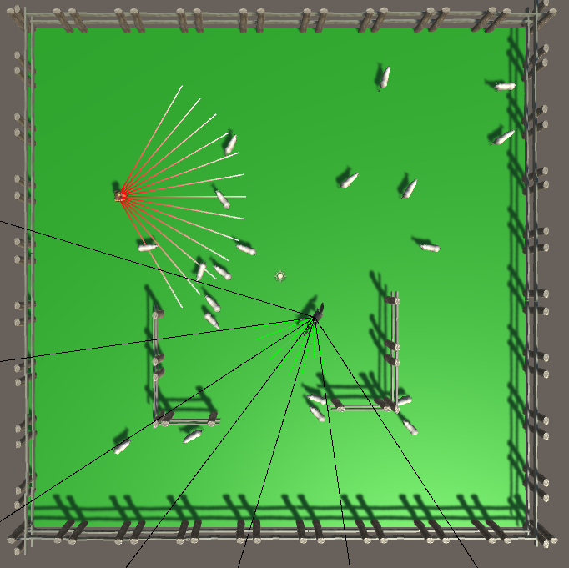
Deep Reinforcement Learning for wolf
Observation data
Black ray:
to detect the environment
and collect observation data
(the distance from wolf to
ray hit point position)
Tag:
using tag to mark ray-hit
gameobject (sheep, boss, fence)
Reward
Eat a sheep: AddReward(1f);
Green ray:
when hit sheep
Wolf die: SetReward(-1f); Done();
1. Red ray:
when hit wolf
2. Collision
when wolf collision with fence wall
or obstacle fences
Two Agent Action
Walking front/back
Rotate left/right
Agent Reset(when call Done())
Reset wolf position and rotation
randomly

Slide 14
Deep Reinforcement Learning for wolf
Training with Proximal Policy Optimization(PPO)
Batch_size: number of experiences used for one iteration of a gradient descent update
Buffer_size: how many experiences should be collected before updating model
Hard to determine perfect size.

Slide 15
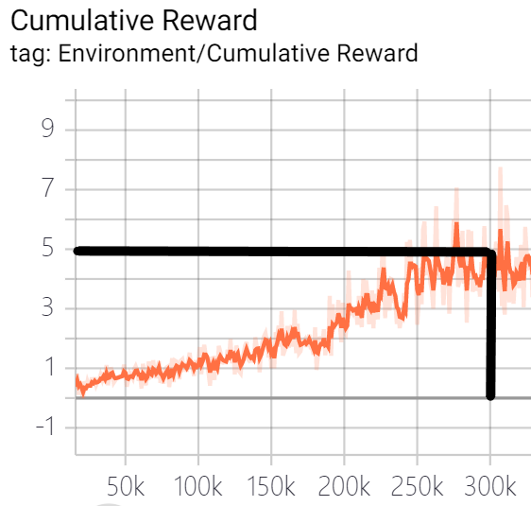
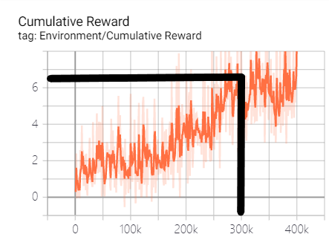
Deep Reinforcement Learning for wolf
Training with Proximal Policy Optimization(PPO)
6400 buffer size
1000 buffer size
The smaller buffer size - faster training updates but less stable.
The larger buffer size - more stable training updates.

Slide 16
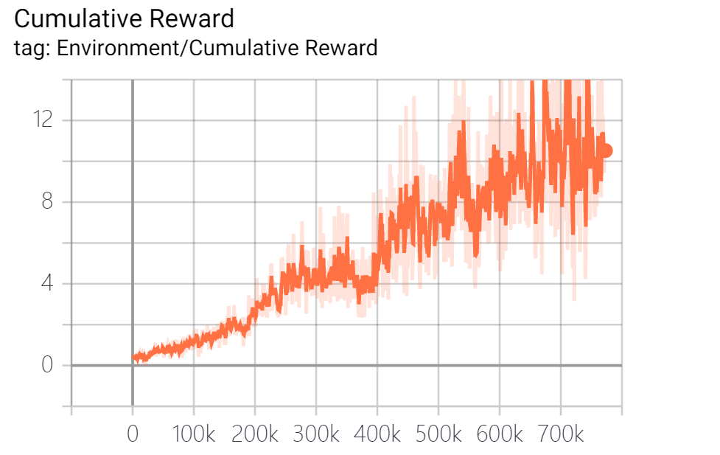
Deep Reinforcement Learning for wolf
Training with Proximal Policy Optimization(PPO)
In reinforcement learning, the goal is to learn a Policy that maximizes reward.
As we define eat a sheep add 1 reward, after 700k steps, the mean reward is
about 11, that means the wolf will eat 11 sheep in average step.

Slide 17
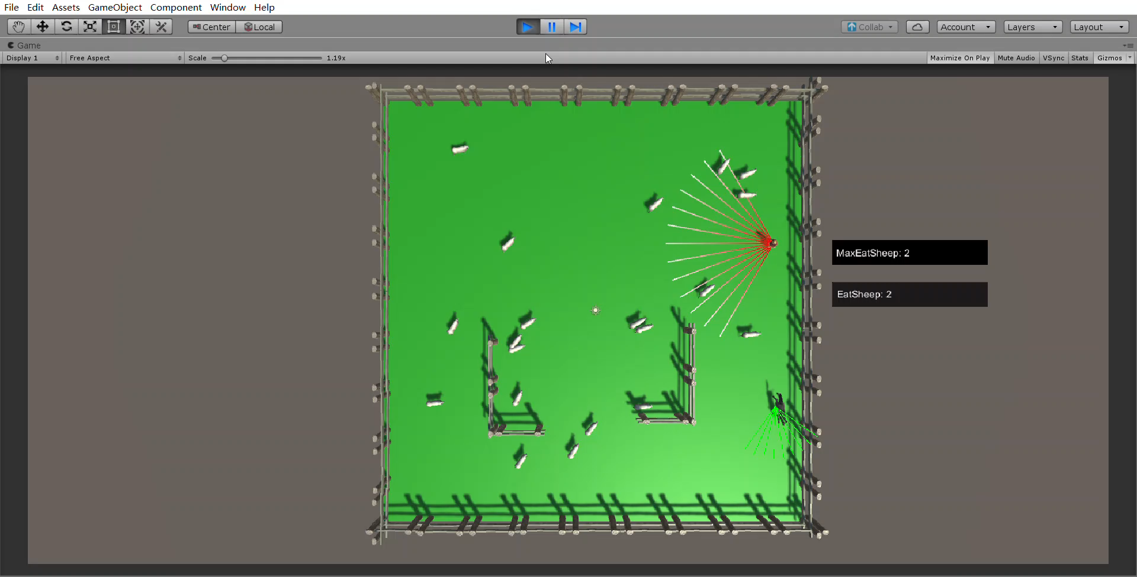
Deep Reinforcement Learning for wolf

Slide 18

Trailer.mp4

Slide 19
Any questions?

